Slide 1
AMOS Sprint 1
Dirk Riehle, Univ. Erlangen
AMOS B01
Licensed under CC BY 4.0 International

Slide 2
Agenda
Capabilities
Stand-up emails
Happiness index
Deliverables
Team contract
Team logo
Team T-shirt
Feature board
Planning document

Slide 3
1. Capabilities

Slide 4
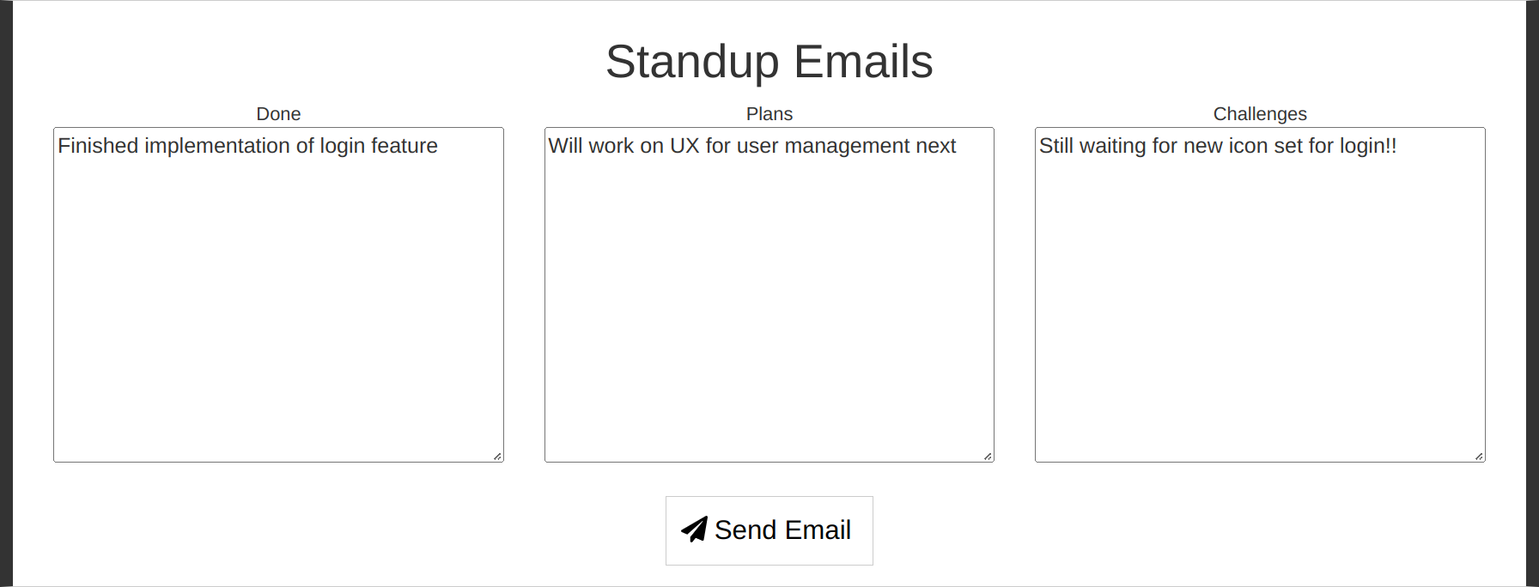
Stand-up Emails
Send stand-up emails using happiness index tool at https://happy-amos.appspot.com/
At least twice in total, on different days of the week
Feel free to have your own separate communication channels

Slide 5
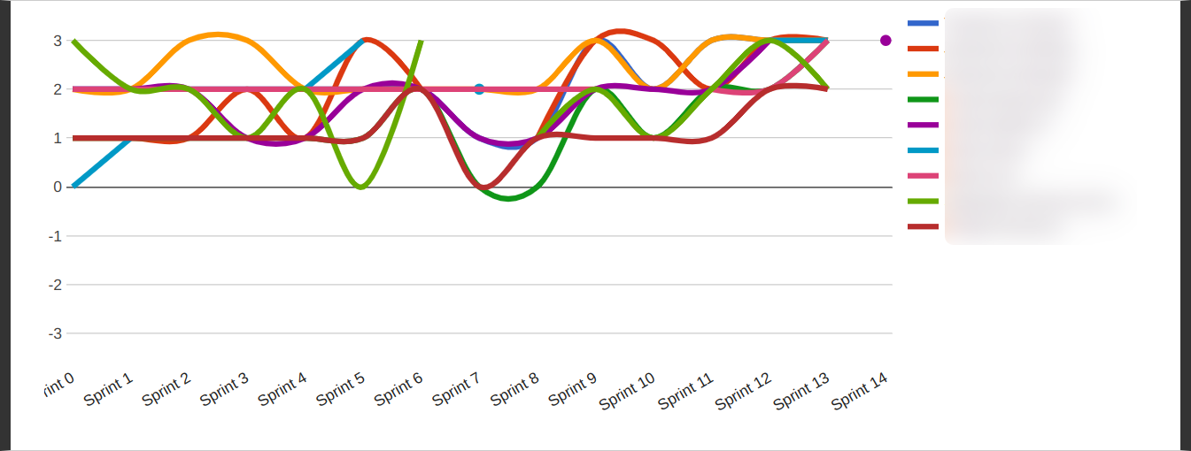
Individual Happiness
Fill in your happiness into happiness index tool
Exactly once in a sprint, during the retrospective section of a team meeting
The window to enter your happiness for the sprint closes at midnight of team meeting day

Slide 6
2. Deliverables

Slide 7
Team Contract
Agree, as a team, on a team contract, and add it to the planning document
Everyone please “sign” (electronically, by typing your name)

Slide 8

Team Logo
Collaboratively design a team logo that you can live with

Slide 9
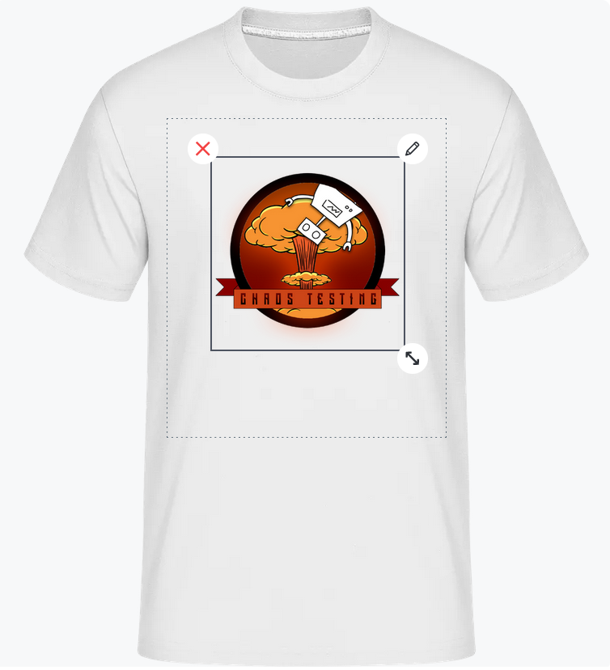
Team T-shirt
Create a team T-shirt design using your logo
You can add your logo and one text
Share your design and add it to planning doc
Also submit your team T-shirt preferences
Black / white
Male / female
Size

Slide 10
Feature Board
Meet your industry partner this week to acquire first batch of features to develop
Add features to product backlog column of feature board
Submit board as screenshot
—
Keep doing this for every sprint from now on

Slide 11
Planning Document
Update planning document as needed
Submit as PDF
—
Keep doing this for every sprint from now on

Slide 12
Thank you! Any questions?
dirk.riehle@fau.de – https://oss.cs.fau.de
dirk@riehle.org – https://dirkriehle.com – @dirkriehle

Slide 13
Legal Notices
License
Licensed under the CC BY 4.0 International license
Copyright
© Copyright 2023 Dirk Riehle, some rights reserved

